Slide 1
Welcome to PHP
Server Side Programming Overview
And file system basics

Slide 2
About Document Root
The document root is established in the apache httpd.conf file.
In the CS department it is “public_html” in your home folder.
For this course, it is “local_html” in your home folder

Slide 3
File Permissions
All HTML and CSS files must be world readable, as must images, etc.
PHP files are special on CS server! They may be restricted to owner.
Tip 1: View your files with ‘ls –al’ so you get in the habit of reading file permissions – always!
Tip 2: You must master the unix command chmod!

Slide 4
Academic Integrity Note
You cannot protect HTML/CSS/image files and have them display properly.
see the previous slide.
You can and must protect your PHP files.

Slide 5
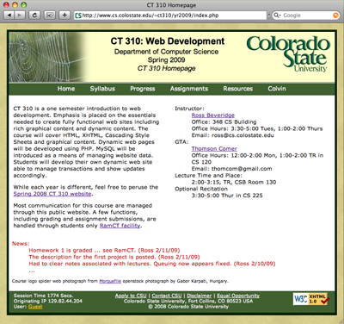
Client-Server Starting Point A Brief Review
Client Computer
Web Server (Apache)
Static Files (index.html)

Slide 6
Add Client/Server Scripting
Client Computer
Web Server (Apache)
File System /cgi-bin
Server Side cgi, Perl, PHP, …
Native Code (enter.exe)
Client Side
(JavaScript)

Slide 7
A Brief Preview
Client Computer
Web Server (Apache)
+
PHP Interpreter
File System (enter.php)
MySQL Database

Slide 8
Context/History
CGI: Common Gateway Interface 1993. Callout to native applications.
CGI + Perl
Applications written in Perl.
Lead to built in Apache Perl Module.
Java
Another possible as Server Side Language.
Not typically built into server as module.

Slide 9
Context/History Continued
Coldfusion
Dynamic html generation environment
Tied to Macromedia - now Adobe
Microsoft .NET Framework
Key modern component of Windows
Includes infrastructure for web development
JavaScript
Typically run on the client side.
Now there is node.js (start 2011)
Security/Sandboxing a concern.
And very widely used - PHP …

Slide 10
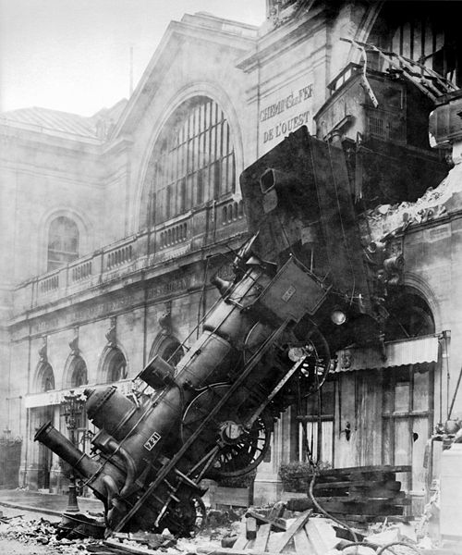
Warning Language Train Wreck is Coming!
So far we’ve covered:
HTML
CSS
Now we introduce
Server Side Programs
Specifically, PHP
Keep your head on …
Five syntaxes,
Client vs. Server view,
All interdependent,
Wikimedia Commons: Train wreck at Montparnasse

Slide 11
PHP resources
The source - the PHP Group (www.php.net).
The PHP Group Tutorial and Manual.
Our zyBooks Text
W3 Schools
W3 School PHP Tutorial.

Slide 12
Learn PHP in 5 easy steps! (PHP Instructors Hate Him!)
public class Easy{
public static void main(String[] args){
Easy e = new Easy();
String toPrint = "Hello" + " " + "People!";
e.printSomething(toPrint);
}
public boolean printSomething(String something){
System.out.println(something);
return true;
}
}

Slide 13
Learn PHP in 5 easy steps! 1. PHP is dynamically typed
public class Easy{
public static void main(String[] args){
Easy e = new Easy();
String toPrint = "Hello" + " " + "People!";
e.printSomething(toPrint);
}
public boolean printSomething(String something){
System.out.println(something);
return true;
}
}

Slide 14
Learn PHP in 5 easy steps! 2. Variables start with $
public class Easy{
public static main($args){
$e = new Easy();
$toPrint = "Hello" + " " + "People!";
e.printSomething($toPrint);
}
public printSomething($something){
System.out.println($something);
return true;
}
}

Slide 15
Learn PHP in 5 easy steps! 3. Call a function a function
public class Easy{
public static function main($args){
$e = new Easy();
$toPrint = "Hello" + " " + "People!";
e.printSomething($toPrint);
}
public function printSomething($something){
System.out.println($something);
return true;
}
}

Slide 16
Learn PHP in 5 easy steps! 4. Speaking of calling functions…
public class Easy{
public function printSomething($something){
echo($something);
return true;
}
}
//No main in PHP!
$e = new Easy();
$toPrint = "Hello" + " " + "People!";
$e->printSomething($toPrint);

Slide 17
Learn PHP in 5 easy steps! 5. Know the language basics
public class Easy{
public function printSomething($something){
echo($something);
return true;
}
}
//No main in PHP!
$e = new Easy();
$toPrint = "Hello" . " " . "People!";
$e->printSomething($toPrint);

Slide 18
Learn PHP in 5 easy steps! Done!
public class Easy{
public function printSomething($something){
echo($something);
return true;
}
}
//No main in PHP!
$e = new Easy();
$toPrint = "Hello" . " " . "People!";
$e->printSomething($toPrint);

Slide 19
Basics
Server runs all *.php files through PHP interpreter before sending to client
Special language constructs
pretend to be functions
These include
print, echo, include, require, return, exit, array
<?php
print “Hello World!”;
?>
Vs.
<?
print “Hello World!”;
?>

Slide 20
Echo, Print, Comments
echo and print both output strings
echo allows for multiple parameters to be passed
print acts more like a function and only allows one
// and # comment out single lines
/* blah blah */ comment out blocks of text

Slide 21
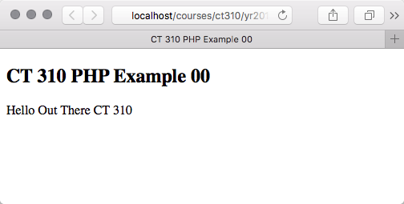
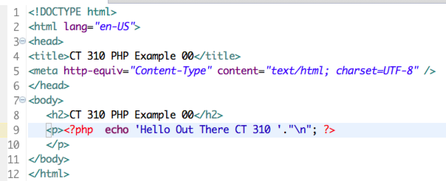
Example – 00

Slide 22
What the Client Sees!
PHP code NEVER leaves the server.
Paying attention to how another person will see the source is like?
Keeping your house clean.
Cleaning behind the refrigerator.

Slide 23
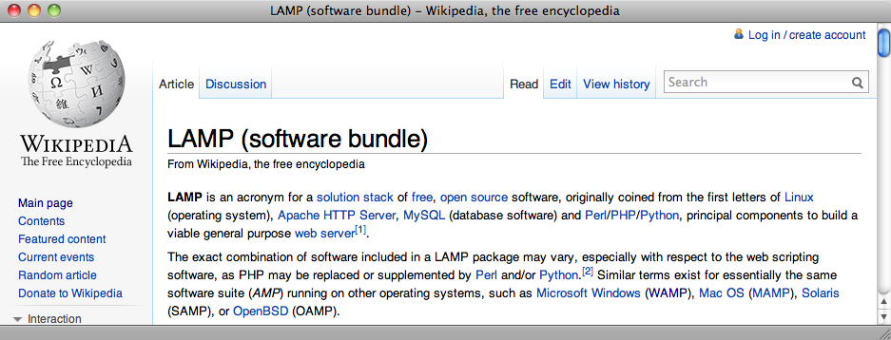
More about Your Machine
Looking ahead to PHP and MySQL
Look up LAMP, MAMP, WAMP

